Slide 1
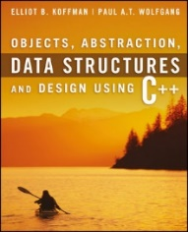
Welcome to
CS 235 Data Structures
C++ Primer (03)
P.2-3, pgs. 7-16

Slide 2
Anything Wrong?
A.h
B.h
htest.cpp
class A
{
int x;
};
#include "B.h"
int main()
{
A a;
B b;
}
class A
{
int x;
};
#include "A.h"
class B
{
A a;
};
class A
{
int x;
};
class A
{
int x;
};
class B
{
A a;
};
int main()
{
A a;
B b;
}
#include "A.h"
#include "B.h"
int main()
{
A a;
B b;
}
Redefinition of class A
Running g++ htest.cpp results in the following error:
In file included from B.h:1, from htest.cpp:2:
A.h:2: error: redefinition of 'class A'
A.h:2: error: previous definition of 'class A'
The class A is being defined twice, once when it is included in htest.cpp and once when it is included into B.h which is included in htest.cpp.

Slide 3
Tip #03: C Header Files
A.h
B.h
htest.cpp
#ifndef A_H_
#define A_H_
class A
{
int x;
};
#endif
#ifndef B_H_
#define B_H_
#include "A.h"
class B
{
A a;
};
#endif
#include "A.h"
#include "B.h"
int main()
{
A a;
B b;
}
Use header guards on all .h and .hpp files!
While "#pragma once" is supported across most compilers, it is not part of the C++ standard.
Header guards are conditional compilation directives that take the following form:
#ifndef FILE_NAME_H_
#define FILE_NAME_H_
...
#endif // FILE_NAME_H_

Slide 4
C++ Variables
A translation unit is the basic unit of compilation in C++.
It consists of the contents of a single source file, plus the contents of any header files directly or indirectly included by it, minus those lines that were ignored using conditional preprocessing statements.
A single translation unit can be compiled into an object file, library, or executable program.
foo()
{
int *p;
{
int x = 5;
p = &x;
}
int y = *p;
}
The variable x does not exist beyond its scope.
y exhibits Undefined Behavior
Scope is the region or section of code where a variable can be accessed.
Lifetime is the time duration where an object/variable is in a valid state.

Slide 5
C++ Tool Chain

Slide 6
Compiling a C++ Program
C/C++ Code
Source Files
Preprocessor
Translation Units
Code Generator
Assembler Code
Assembly Code
Library-build
Process
Assembler
Object Code
Object Files
Object Files
Linker
Linker
Machine Code
Machine Code
Object File
Executable
Object File
Executable

Slide 7
Compilers vs Interpreters
Compiler
Assembler
Linker
Application
Assembly
Object
code
Machine
code
temp = a;
a = b;
b = temp;
MOV 0x01(SP),R14
MOV SP,R15
INCD R15
ADD R15,R14
MOV @R14,0x00(SP)
MOV 0x01(SP),R14
INC R14
415E 0001
410F
532F
5F0E
4EE1 0000
415E 0001
531E
01000001
01011110
00000001
01000001
00001111
High-level
language
statements
Interpreter
Source
code
temp = a
a = b
b = temp
= Executable
= Data Path

Slide 8
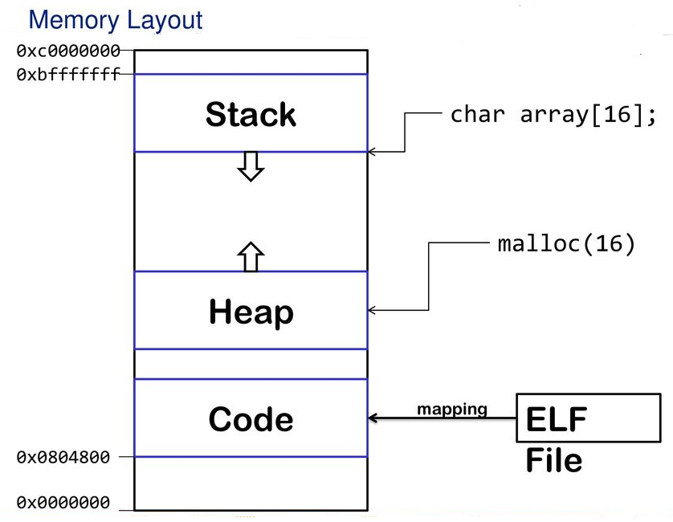
C++ Memory Model

Slide 9
C++ Memory Model
The C++ memory model is an abstract machine for which the C++ programming language is defined.
Simplified memory model (closely related to how a real computer memory looks.)
Memory is one or more contiguous sequences of bytes.
A byte is a sequence of 8 or more bits and "bit" is a unit of storage large enough to hold one of two values.
Each byte is associated with a unique identifier known as its address.
Computer memory is classified as
Writable or non-writable.
Executable or non-executable.
Initialized or uninitialized.
High Address |  | Environment variables
 | Stack | Managed automatically by compiler
 | Dynamic Data (Heap) | malloc/free new/delete
 | Static Data (global variables) | Un-initialized
 | Initialized Data (global variables, literals) | Initialized to zero by O.S.
Low Address | Program Code | Read from program file by O.S.
Managed automatically by compiler
(writable, non-executable)
High
Address
Available Memory
Managed by programmer
(writable, non-executable)
Created by programmer
(readable, non-executable)
Initialized when program starts
(readable, non-executable)
Read from a program file by exec (executable)
Low
Address

Slide 10
C++ Memory Model
High Address |  | Environment variables
 | Stack | Managed automatically by compiler
 | Dynamic Data (Heap) | malloc/free new/delete
 | Static Data (global variables) | Un-initialized
 | Initialized Data (global variables, literals) | Initialized to zero by O.S.
Low Address | Program Code | Read from program file by O.S.
#include <iostream>
using namespace std;
int x;
int main(int argc, char* argv[])
{
int y;
int* z = (int*)new int[10];
z[6] = 100;
return 0;
}
z
10 ints

Slide 11
With the help of your neighbor...
#include <iostream>
using namespace std;
int apple = 1;
int main(int argc, char* argv[])
{
{
int apple = 3;
cout << apple << endl; // (a)
{
cout << apple << endl; // (b)
cout << :: apple << endl; // (c)
apple = 2;
}
cout << apple << endl; // (d)
}
{
cout << apple << endl; // (e)
}
return 0;
}

Slide 12
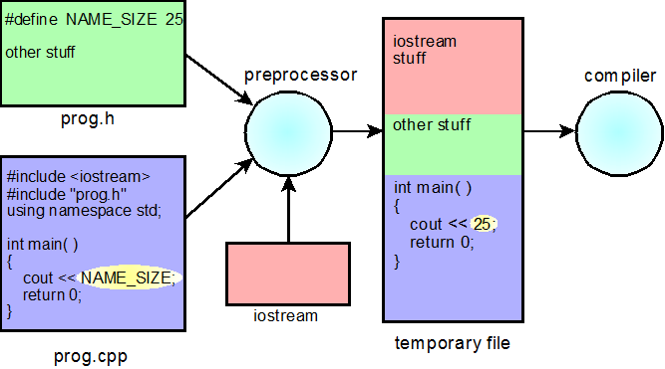
P.2 Preprocessor Directives and Macros
Removing Comments
Macros
Conditional Compilation
More on the #include Directive
P.2 Preprocessor Directives and Macros

Slide 13
C/C++ Preprocessor
Directive | Description
#define | Substitutes a preprocessor macro
#include | Inserts a particular header from another file
#undef | Undefines a preprocessor macro
#ifdef | Returns true if this macro is defined
#if | Tests if a compile time condition is true
#else | The alternative for #if
#elif | #else and #if in one statement
#endif | Ends preprocessor condition
#error | Prints error message on stderr
#pragma | Issues special commands to the compiler, using a standardized method
#warning | Compiler emits a diagnostic containing the remaining tokens in the directive
#line | Set the __FILE__ and __LINE__ macros of the line following the directive
#define MAX_STUDENTS 1000
#define MAX(x,y) (x < y ? x : y)
#include <iostream>
#include "snap.h"
#if 0
// don’t compile
#else
// compile
#endif

Slide 14
Conditional Compilation
Six preprocessor directives are available to control blocks of conditional compilation.
Begin directives are #if, #ifdef, and #ifndef.
Alternative blocks use #else, and #elif.
End of block marked by #endif.
If the condition is true (non-zero), then all lines between the matching #else (or #elif) and the #endif directive are ignored and not passed to the compiler.
Use constant-expressions.
Compilation time inclusion/exclusion (not run-time).
Ensure defined/default values.
Unlike /* */, these directives can be nested.
Useful for keeping old code around for future reference.
#if true #if true
. .
. .
. .
#elif true .
. #else
. #if false
. .
#endif .
.
#endif
#endif

Slide 15
P.3 C++ Control Statements
Sequence and Compound Statements
Selection and Repetition Control
Nested if Statements
The switch Statement
P.3 C++ Control Statements

Slide 16
Control Statements
Control
Statement
Selection
Iteration
Jump
if
if-else
switch
for
while
do
break
continue
return

Slide 17
Switch
A switch statement allows a variable to be tested for equality against a list of values or case.
The switch/case expressions must have an integral or enumerated type.
Statements following a case will execute until a break statement (or end of switch.)
An optional default case usually appears at the end of the switch.
switch example | if-else equivalent
switch (x) { case 1: case 2: case 3: cout << "1, 2, or 3"; break; default: cout << "Not 1, 2, or 3"; } | if ((x == 1) || (x == 2) || (x == 3)) { cout << "1, 2, or 3"; } else { cout << "Not 1, 2, or 3"; }

Slide 18
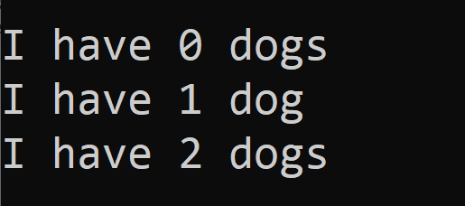
Conditional Expressions
Conditional expression (C++ multiplexor operation)
Format:
<boolean> ? <true expression> : <false expression>
y
z
x ? y : z
0
1
x
x ? y : z
This expression returns the value of y if x != 0, otherwise it returns the value of z.
Examples
for (int dogs = 0; dogs < 3; ++dogs)
cout << endl << "I have " << dogs << " dog" << ((dogs == 1) ? "" : "s");
ostream& out = (argc > 2) ? *(new ofstream(argv[2])) : cout;

Slide 19
Main Function Arguments

Slide 20
Argc and argv
#include <iostream>
#include <fstream>
#include <string>
using namespace std;
int main(int argc, char* argv[])
{
if (argc < 2) return 3;
ifstream in(argv[1]);
if (!in) return 1;
ostream& out = (argc > 2) ? *(new ofstream(argv[2])) : cout;
if (!out) return 2;
string line;
while (in >> line)
{
out << line << endl;
}
if (&out != &cout) delete(&out);
in.close();
return 0;
}
argc:
3
p | r | o | g | r | a | m | . | e | x | e | ∅
argv:
i | n | . | t | x | t | ∅
∅
o | u | t | . | t | x | t | ∅
Open argv[1] for input.
Open argv[2] for output if argc > 2,
else use cout for output.
>>program.exe in.txt out.txt
argv[0]
argv[1]
argv[2]

Slide 21
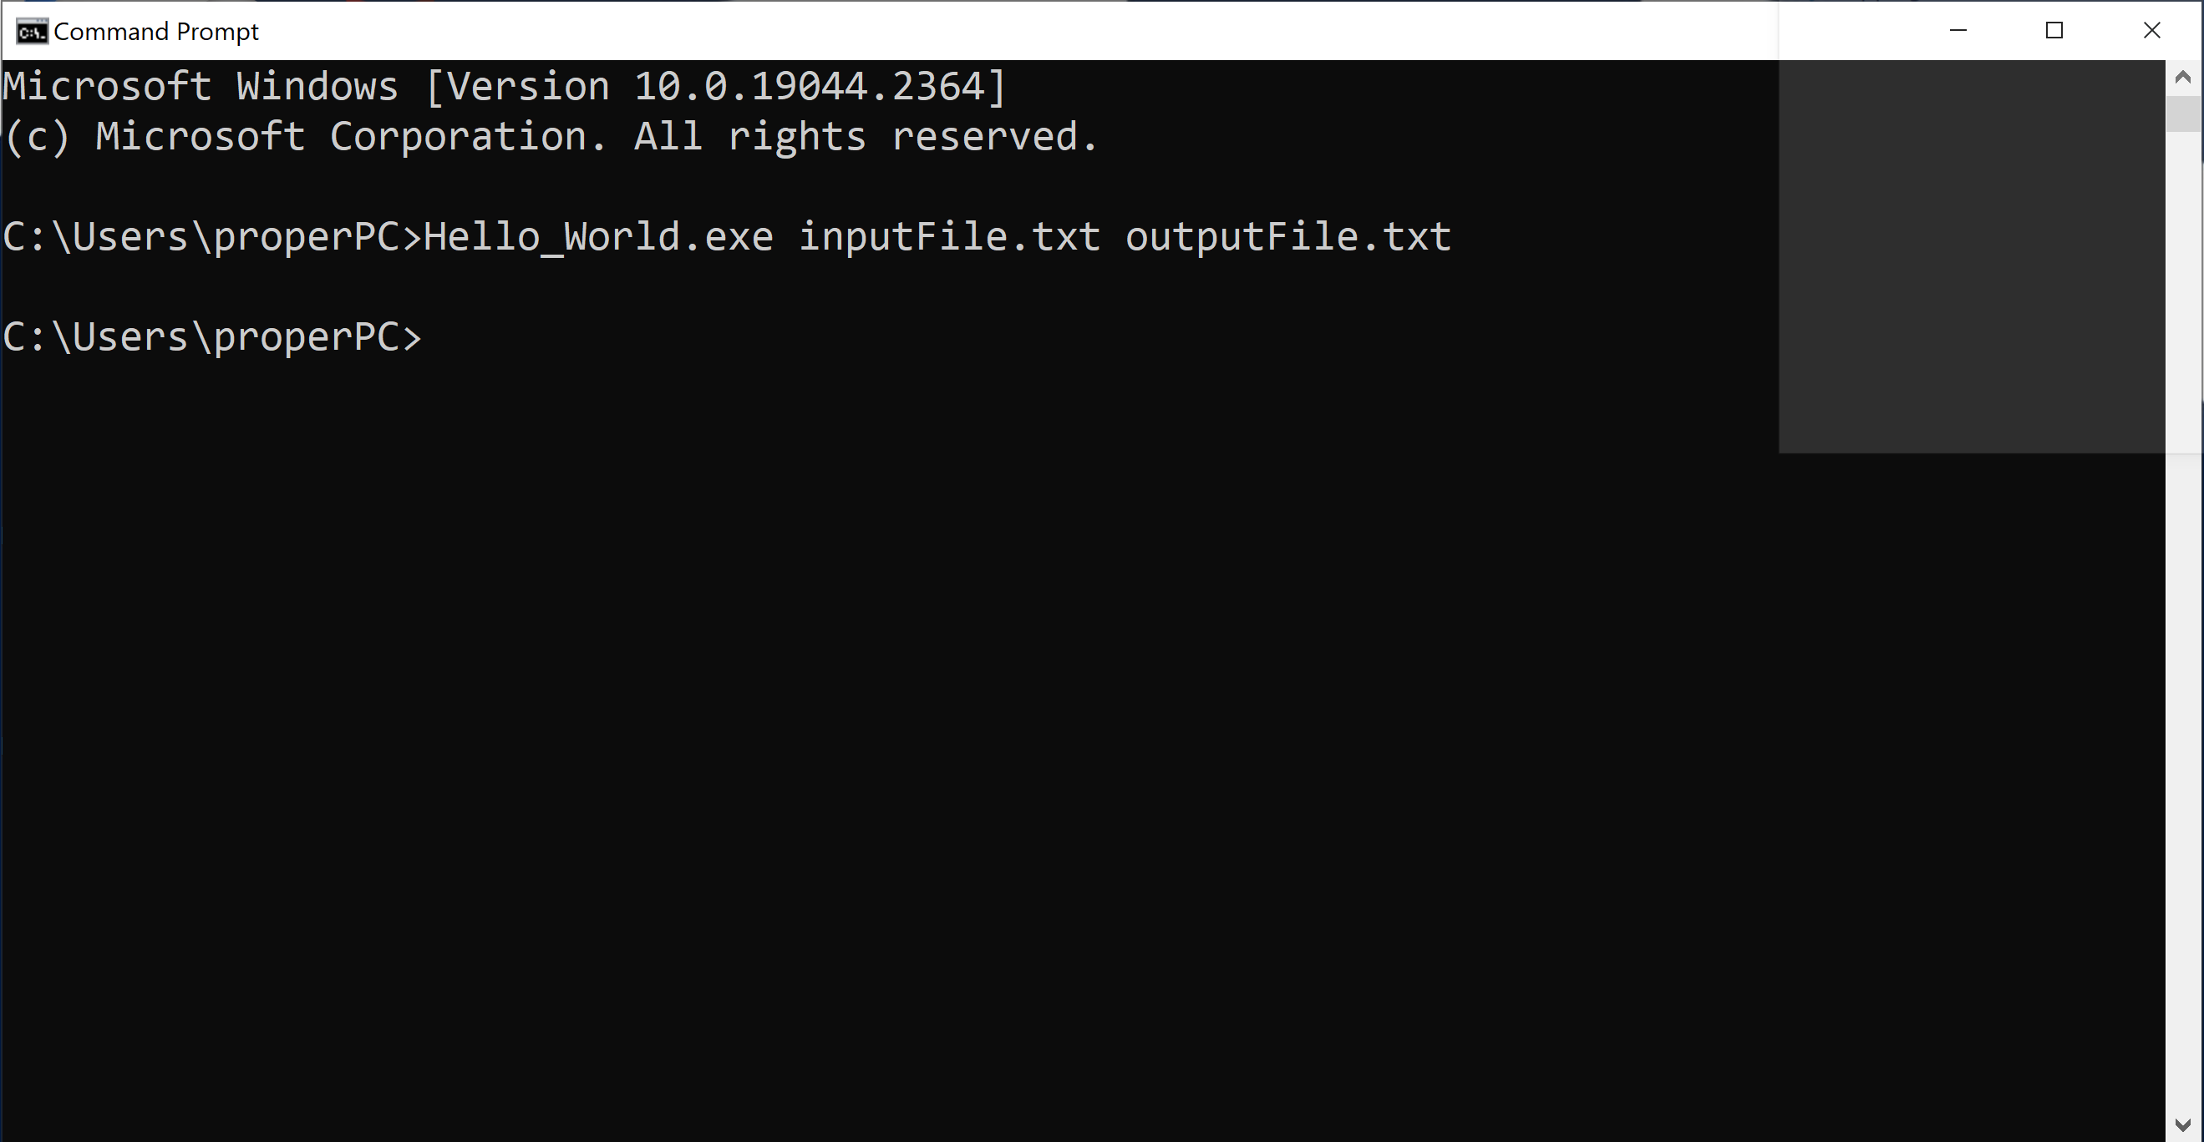
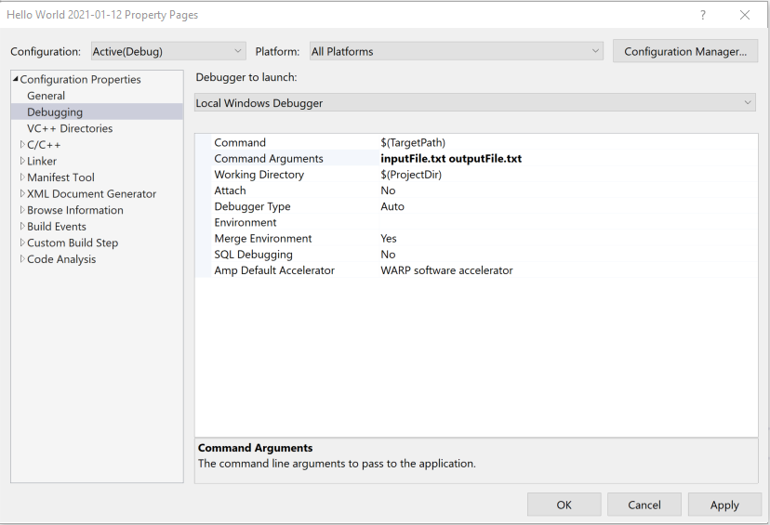
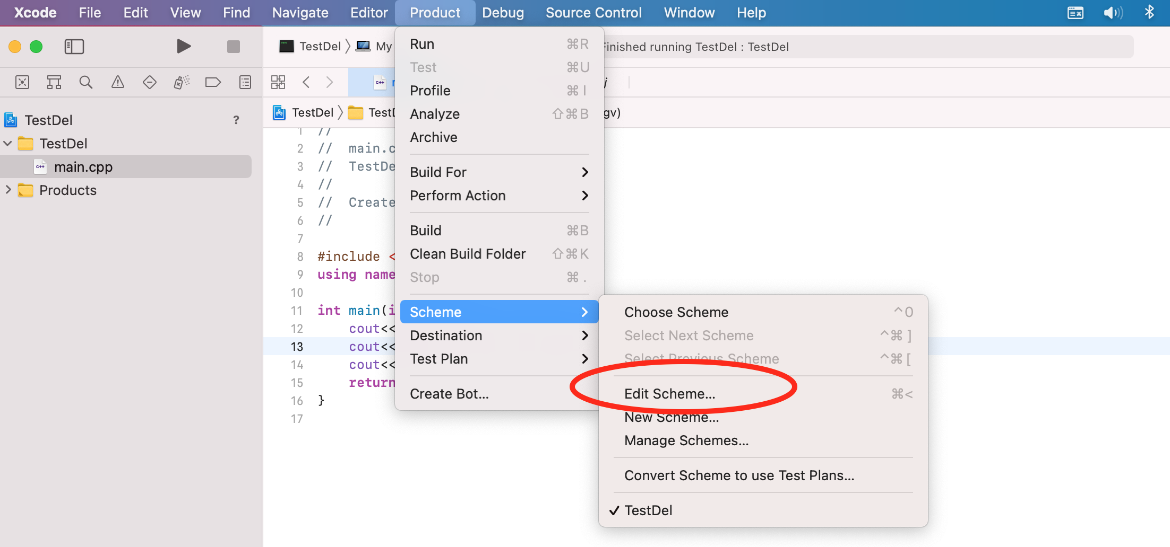
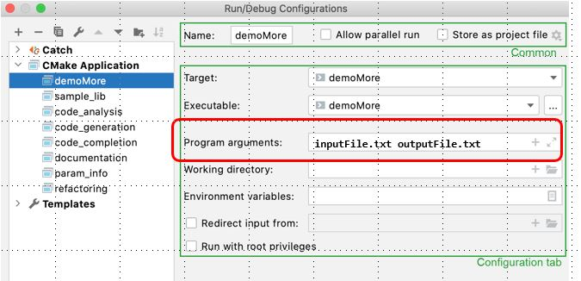
Argc and argv
CLion
XCode
Visual Studio
Command Prompt

Slide 22
Be Safe

